Slide 1



Global conservation of species’ niches
Jeffrey Hanson
jeffrey.hanson@uqconnect.edu.au
jeffrey-hanson.com

Slide 2


Acknowledgements
Richard Fuller
Jonathan Rhodes
Stuart Butchart
Graeme Buchanan
Carlo Rondinini
Francesco Ficetola
NeCTAR

Slide 3
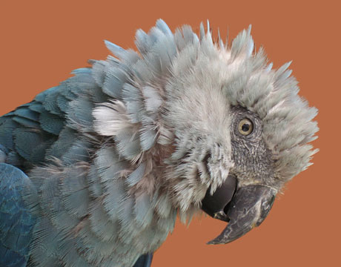
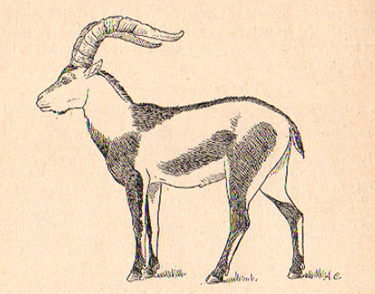

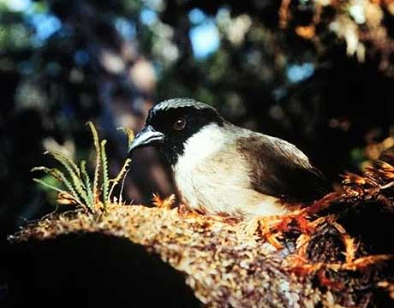
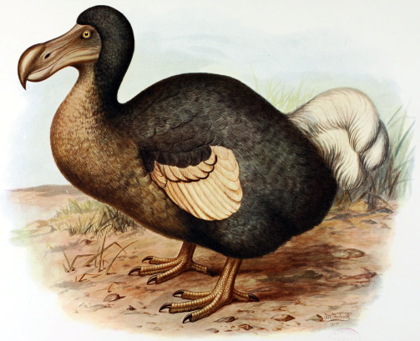
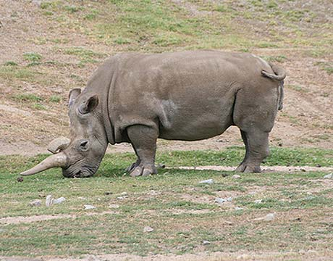
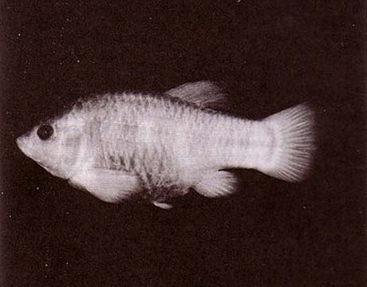
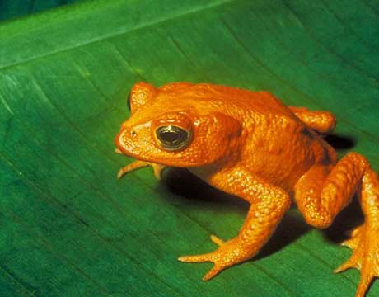
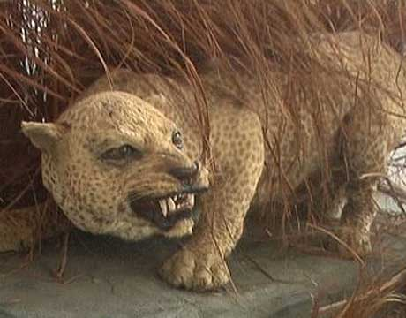
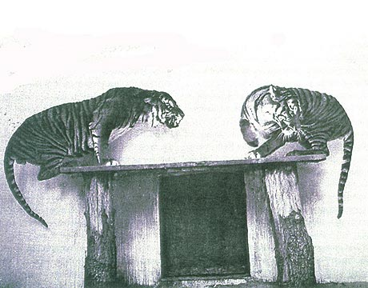
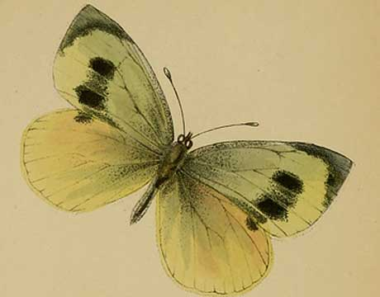
Global biodiversity crisis
Notes:
- high extinction rate
- conservation aims to maintain existing patterns of biodiversity and the processes that sustain them
- areas set aside to preserve biodiversity, and spearhead direct management actions

Slide 4
Protected areas

Slide 5
Local adaptation
Species range
Population

Slide 6
Local adaptation
Species range
Population

Slide 7
Local adaptation
Species range
Population

Slide 8
Research questions
How well are protected areas capturing environmental diversity in species’ habitats?
Where should new protected areas be established to address these shortfalls?

Slide 9
Stack
Data wrangling:
R: “dplyr”, “dbplyr”, “feather”, “data.table”, “ggplot2”, and many more packages
Spatial processing
R: “sp” and “raster” R packages
Python: “arcpy” spatial library (Windows only)
Optimization
Gurobi
R: “prioritizr” R package

Slide 10
Data
Suitable habitat maps for species worldwide
Global climate variables
Protected area boundaries

Slide 11
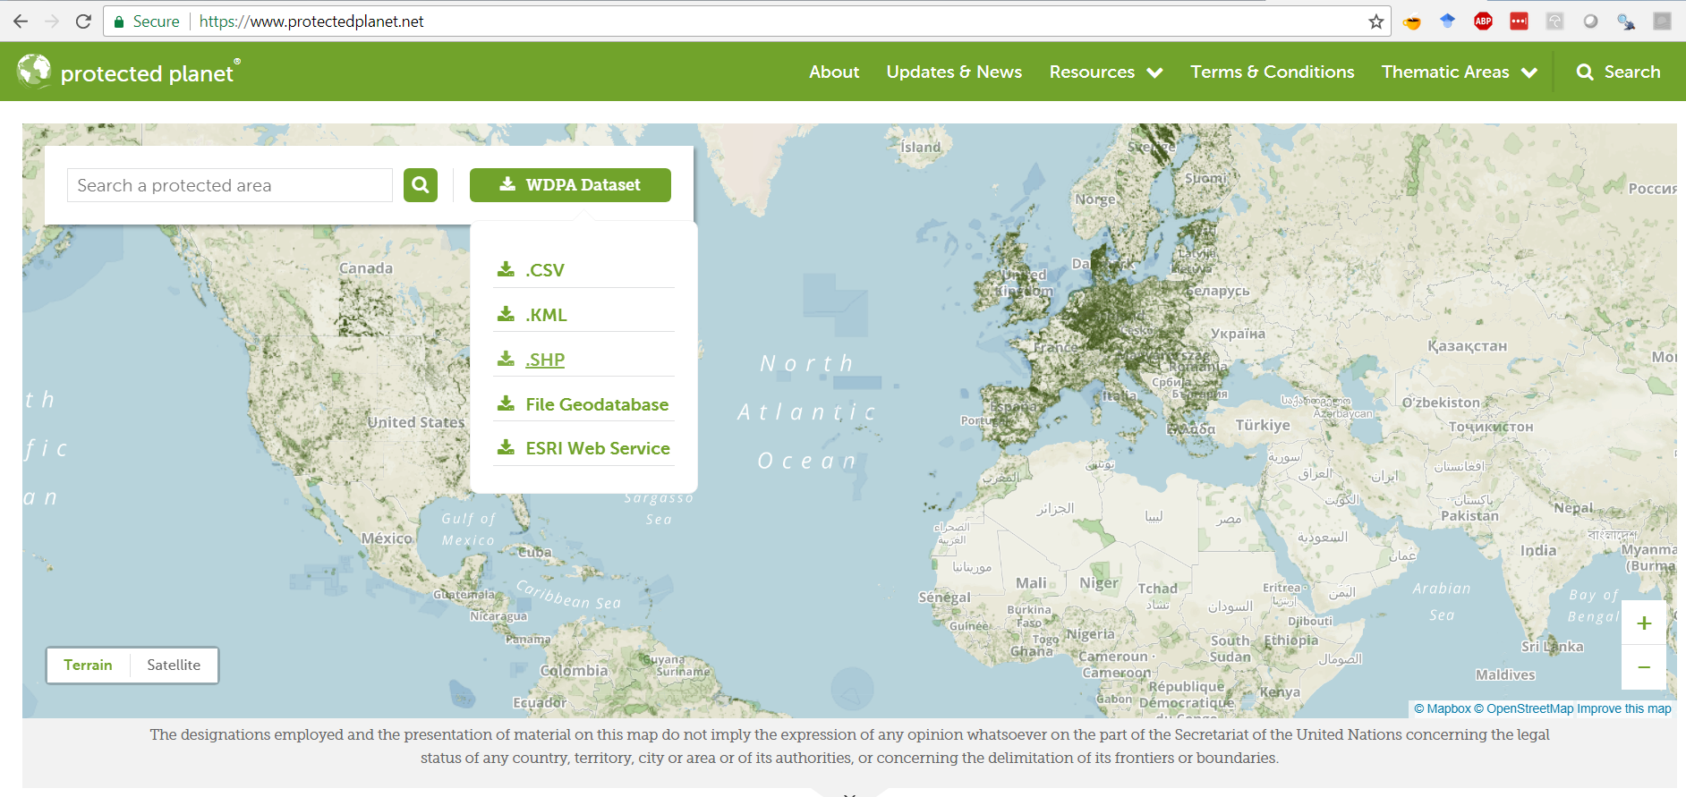
World Database on Protected Areas
Corrupt file!
SHOW PICTURE OF DOWNLOAD PAGE

Slide 12
World Database on Protected Areas

Slide 13
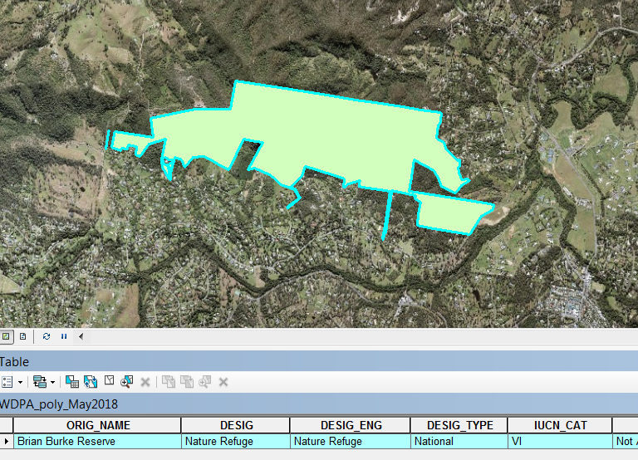
World Database on Protected Areas
- “Vector” data
- Tabular “attribute” data
Each row is associated with a “polygon”, “line” or “point” geometry
Data for 234’694 protected areas

Slide 14
World Database on Protected Areas
Need to be cleaned and standardized…
SHOW PICTURE OF INVALID GEOMETRY

Slide 15
World Database on Protected Areas
Need to be cleaned and standardized…
SHOW PICTURE OF PROTECTED AREA REPRESENTED AS POINTS

Slide 16
World Database on Protected Areas
Need to be cleaned and standardized…
SHOW PICTURE OF PROPOSED PROTECTED AREA

Slide 17
World Database on Protected Areas
Need to be cleaned and standardized…
SHOW PICTURE OF OVERLAPPING PROTECTED AREA

Slide 18
World Database on Protected Areas
Need to be cleaned and standardized…
SHOW PICTURE OF BINARY GRID INDICATING IF PROTECTED OR NOT

Slide 19
Extent of suitable habitat maps
Habitat maps for 19,926 species (raster data)
INSERT EXAMPLE HERE SHOWING SPP HABITAT MAP

Slide 20
Extent of suitable habitat maps
Also need standardizing…
INSERT EXAMPLE HERE SHOWING DIFFERENT RESOLUTIONS

Slide 21
Extent of suitable habitat maps
Also need standardizing…
INSERT EXAMPLE HERE SHOWING DIFFERENT EXTENTS

Slide 22
Extent of suitable habitat maps
Also need standardizing…
INSERT EXAMPLE HERE SHOWING DIFFERENT COORDINATE SYSTEMS

Slide 23
Global climatic variables
SHOW PICTURES OF MAPS

Slide 24
Create climatic partitions
SHOW PICTURE WITH SPP HABITAT MAP + climatic conditions + clustering analysis

Slide 25
Calculate targets and asses performance
SHOW GRAPH WITH TARGETS VS TOTAL EXTENT OF SUITABLE HABITAT

Slide 26
How well are existing protected areas covering species’ niches?

Slide 27
SHOW HISTOGRAM OF HOW WELL SPECIES ARE REPRESENTED

Slide 28
SHOW EXAMPLE WITH FROG

Slide 29
SHOW EXAMPLE WITH PANDA

Slide 30
Where should we establish new areas to address these shortfalls?

Slide 31



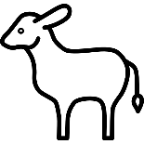

Reserve selection

Slide 32

Reserve selection
Minimize cost
subject to targets

Slide 33
Reserve selection
Minimize cost
subject to targets

Slide 34
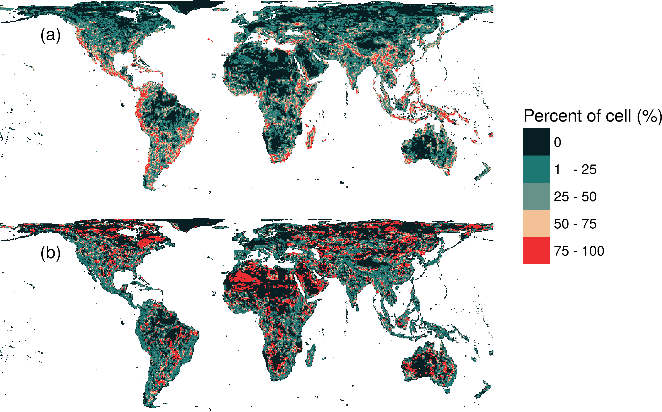
Priority areas for protection
34.6 % of the Earth land when combined with existing protected areas

Slide 35
What if we didn’t account for environmental conditions?

Slide 36
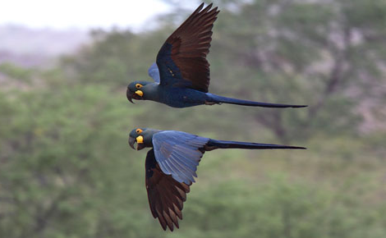
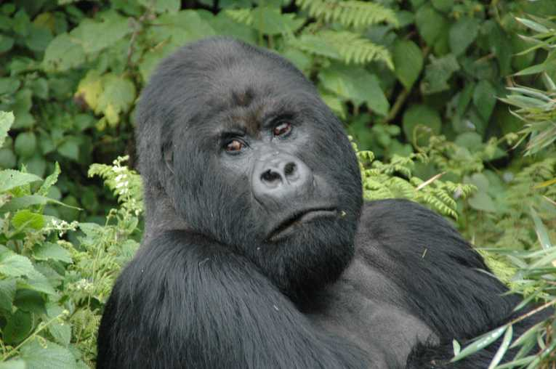
Take home messages
Current protected area system is insufficient
More protected areas are needed to fill the gaps
Future conservation efforts need to explicitly account for environmental variation

Slide 37



jeffrey.hanson@uqconnect.edu.au
github.com/jeffreyhanson
jeffrey-hanson.com

